Slide 1
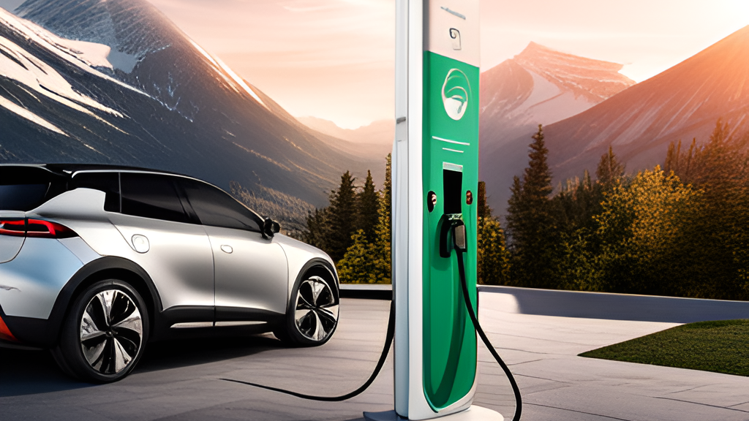
Zero Emission Vehicles DAB 202: Data Visualization & Reporting

Slide 2



Group 6
Ambily Treesa Varghese
Dileep Sathyan
Manushree Venkatesh
Pratinav Jinwal

Slide 3

Introduction
Electric vehicles (EVs) are becoming increasingly popular as people look for ways to reduce their carbon footprint and save money on gas.
EV type currently in market are Battery Electric Vehicle(BEV), Plug-in Hybrid Electric Vehicle(PHEV) and Fuel Cell Electric Vehicle(FCEV)
Zero-Emission Vehicles (iZEV) program, was introduced by the Canadian government to encourage more people to switch to EVs.
This program provides incentives to Canadians who purchase or lease eligible EVs.
It's important that we all do our part to reduce greenhouse gas emissions and protect the environment for future generations.

Slide 4
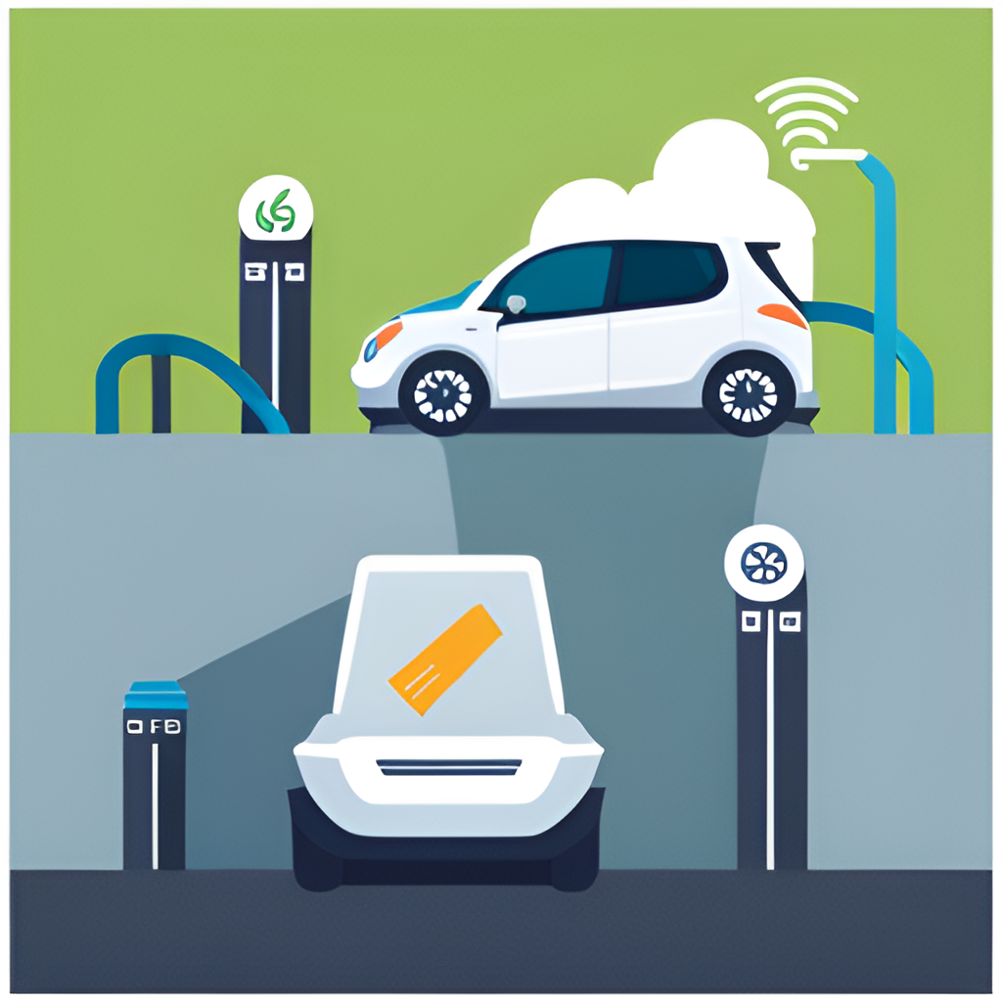
Motivation
Transportation sector is responsible for approximately 25% of Canada's greenhouse gas emissions resulting in climate changes and impacting public health.
Canada is heavily dependent on fossil fuels for transportation vulnerable to price fluctuations and supply disruptions.
Electric vehicles are more efficient than traditional gasoline-powered vehicles.
EV and iZEV programs in Canada reduce greenhouse gas emissions, improve air quality and stimulate innovation and create jobs in the clean energy sector.

Slide 5
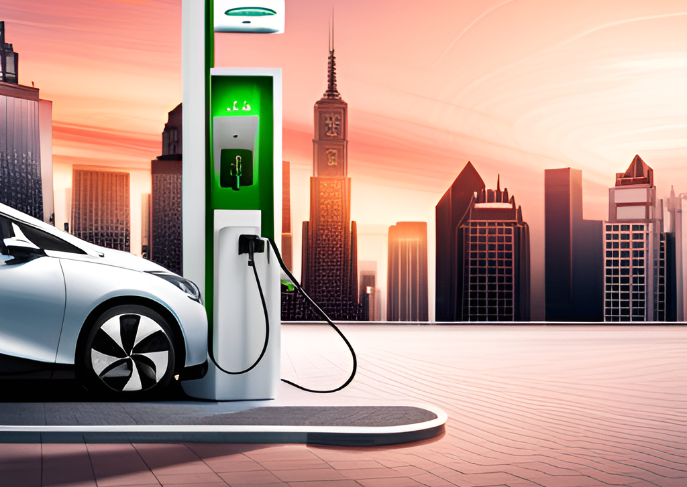
Goals and Objectives
Identify the most popular electric vehicle makes models and types of EVs.
Find the preferred customer dealership provinces and postal codes.
Analyze the trends in incentive claims over the years in provinces.
Observe the pattern in claims by vehicle makes and models.

Slide 6
Dataset Description
Sl# | Variables | Description
1 | Incentive Request Date | Incentive request date
2 | Month and Year | Month and year of the incentive request
3 | Government of Canada Fiscal Year (FY) | Government of Canada fiscal year
4 | Calendar Year | Calendar year in which the request was received
5 | Dealership Province/Territory | Province or Territory of the dealership
6 | Dealership Postal Code | Dealership Postal Code
7 | Purchase or Lease | The vehicle has been purchased or leased
8 | Vehicle Year | Vehicle Year
9 | Vehicle Make | The make of the zero-emission vehicle
10 | Vehicle Model | The model of the zero-emission vehicle
11 | Vehicle Make and Model | Make and model of the zero-emission vehicle
12 | Battery-Electric Vehicle (BEV), Plug-in Hybrid Electric Vehicle (PHEV) or Fuel Cell Electric Vehicle (FCEV) | Battery-Electric Vehicle (BEV), Plug-in Hybrid Electric Vehicle (PHEV), or Fuel Cell Electric Vehicle (FCEV)
13 | BEV/PHEV/FCEV - Battery equal to or greater than 15 kWh or electric range equal to or greater than 50km | Whether the BEV/PHEV/ VÉPC battery is equal to or greater than 15kWh or the electric range is equal to or over 50km
14 | BEV, PHEV ≥ 15 kWh or PHEV < 15 kWh (until April 24, 2022) and PHEV ≥ 50km or PHEV < 50km and FCEVs ≥ 50km or FCEVs < 50km (April 25, 2022, onward) | Indicates the dates when the definition of longer-range plug-in hybrid vehicles (PHEVs/FCEVs) moved from battery size in kilowatts (kWh) to electric range in kilometers (km)
15 | Eligible Incentive Amount | Eligible Incentive Amount (dollars)
16 | Individual or Organization (Recipient) | Individual or Organization (Recipient)
17 | Recipient Province/Territory | Province and Territory of recipients
18 | Country | Country of the recipient
Statistics on the Incentives for Zero-Emission Vehicles (iZEV) was launched by Transport Canada on May 1, 2019.
The dataset contains incentive request data from May 2019 to May 2023, for Canadian Provinces and Dealership Postal Codes.
The dataset contains 220156 records of incentive requests and has 18 variables.

Slide 7
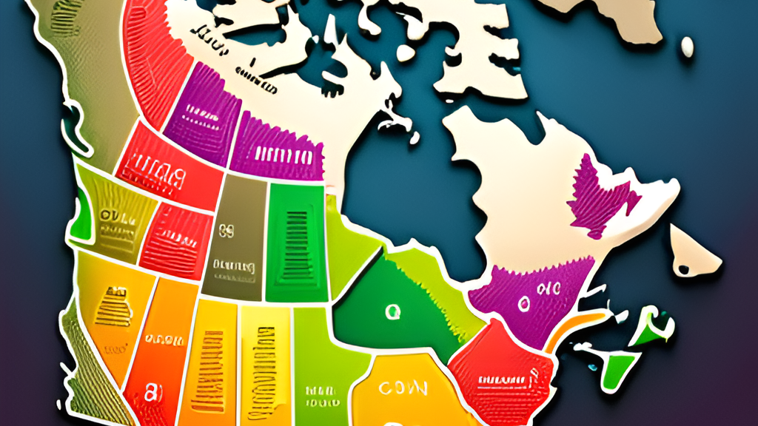
Visualizations

Slide 8
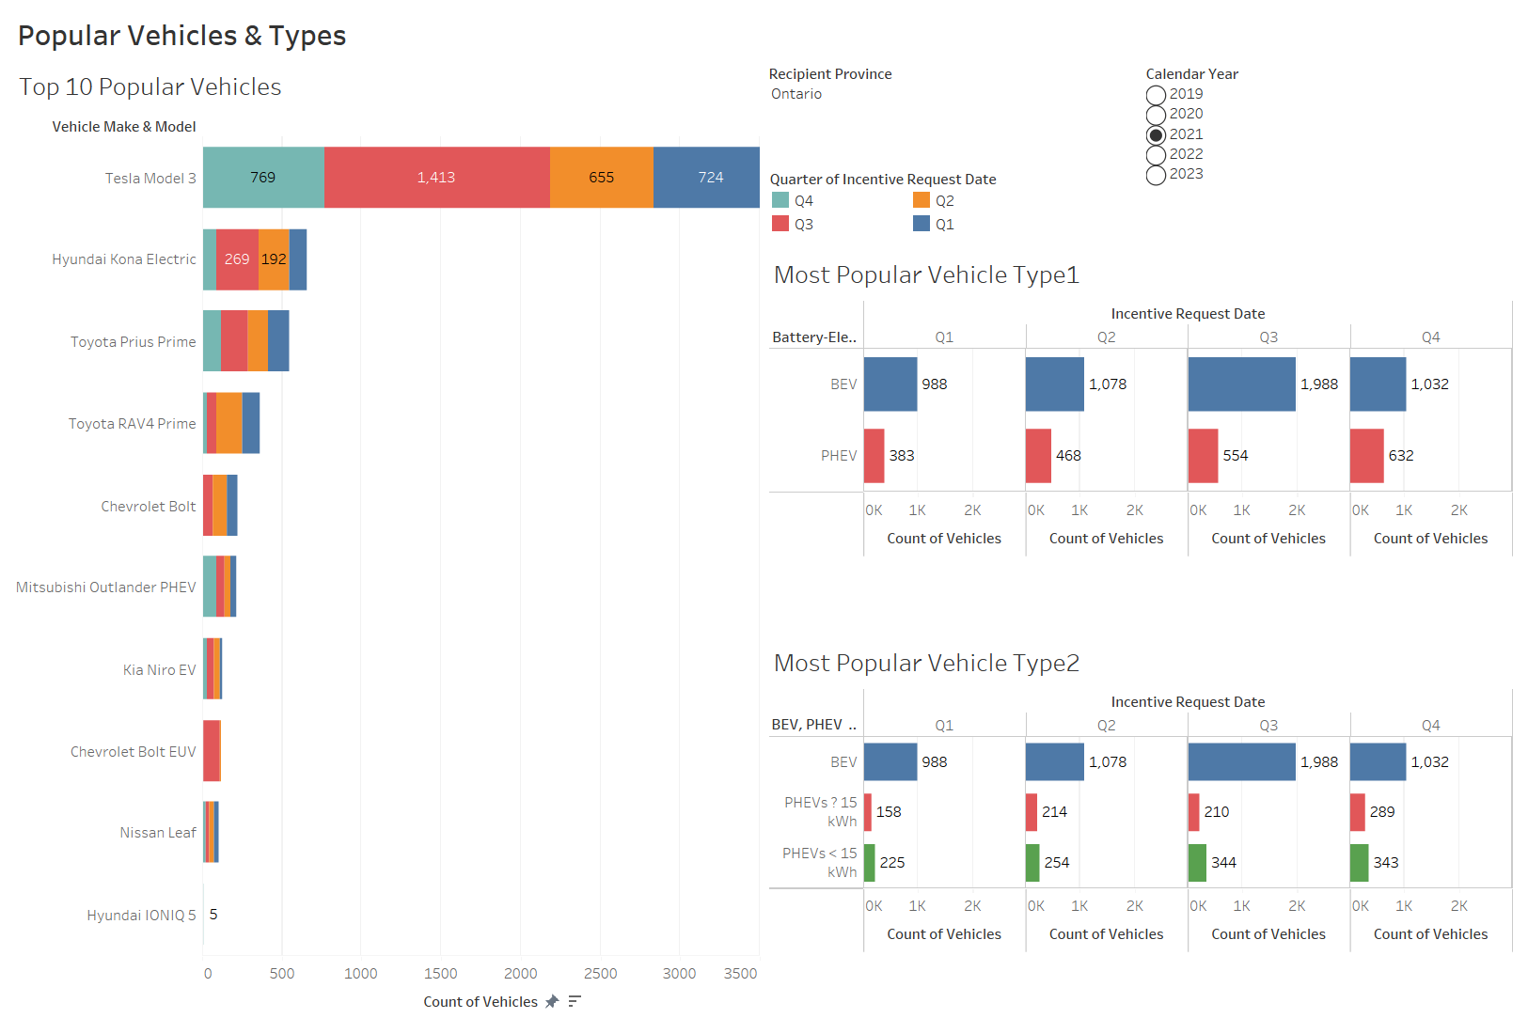

Slide 9
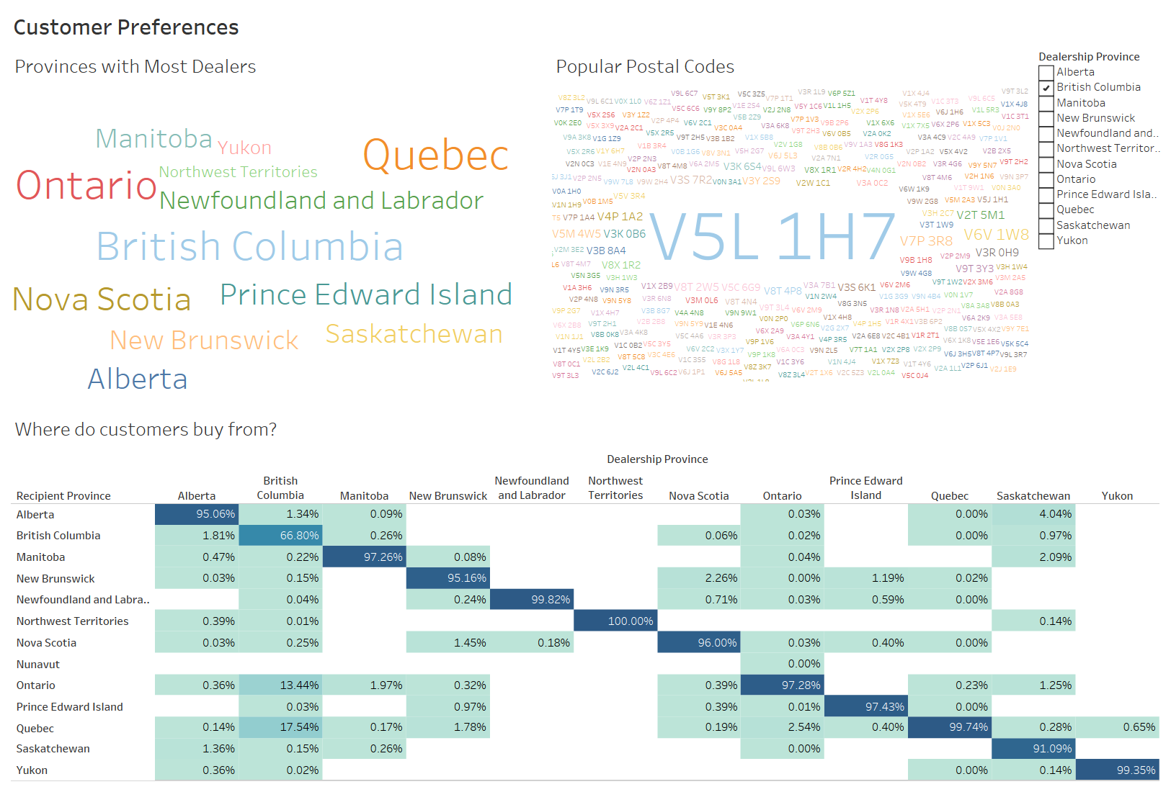

Slide 10
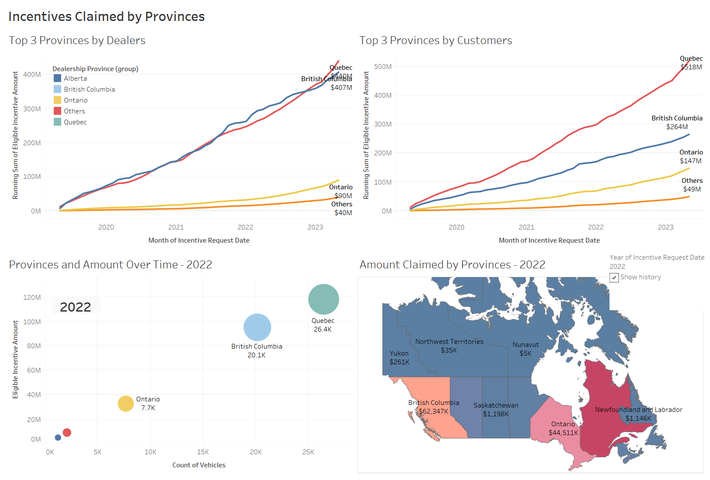

Slide 11
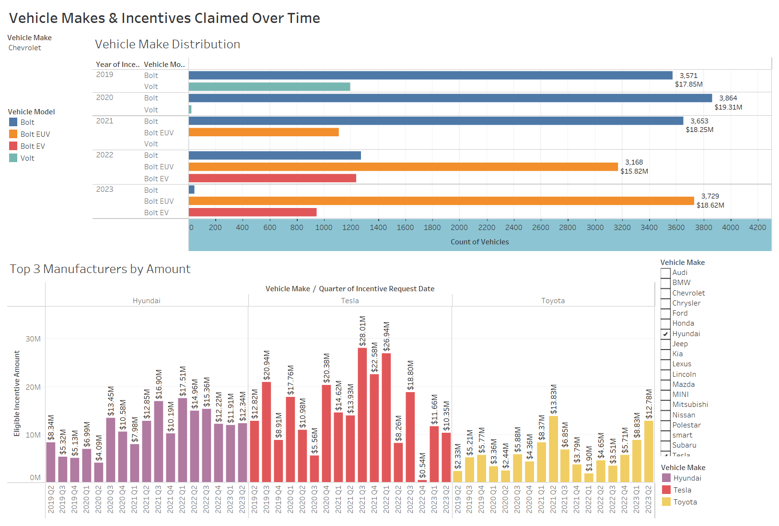

Slide 12
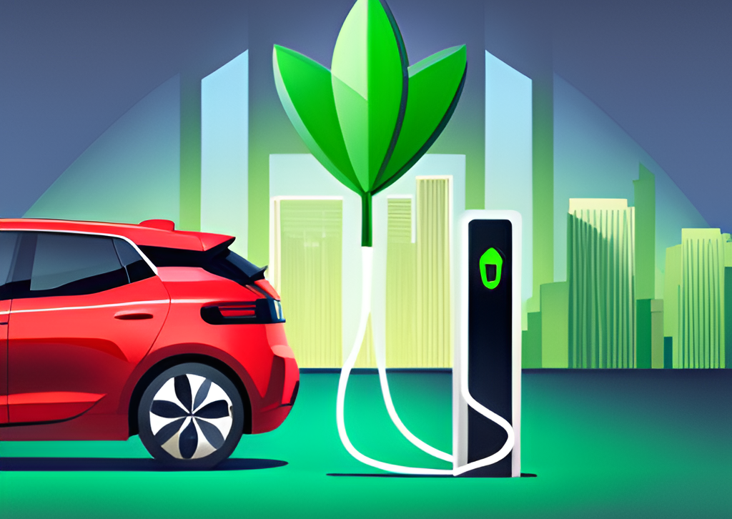
Conclusion
Tesla Model 3 is the car with the most customer base in Canada.
BEV vehicles receive more incentives and are preferred.
British Columbia has the most dealerships and V5L 1H7 is the most popular postal code in terms of Customer’s preference for EV.
Quebec, followed by British Columbia and Ontario are the 3 major provinces in terms of the incentives claimed by EV customers.
Created a dynamic dashboard with appropriate filters to identify the models and makes based on the yearly and quarterly counts of vehicles and amounts claimed by users.

Slide 13
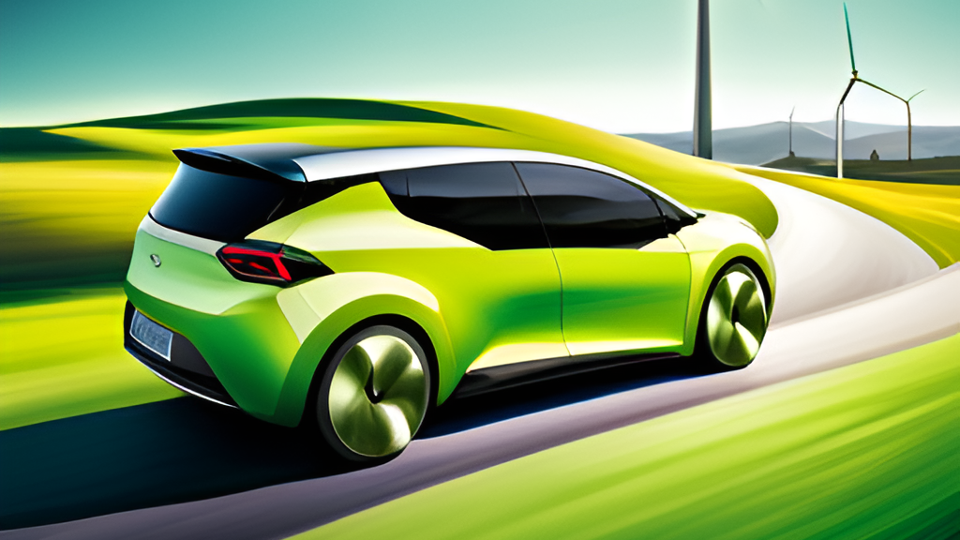
Thank you

